Slide 1
Final report
Memory Forensics Examinations - Super Timeline Creation and Analysis
Notes:
WELCOME SCREEN → “All Content is editable –and- or you can put your logo on there”
Please Read this Notice Before you start working with this Template
Please Install the following Fonts and/or make sure its already available on your system.
Open Sans Family
Available @ fontsquirell.com
Callibri
Microsoft & Office System Font

Slide 2



01
03
NGUYEN DOAN XUAN BINH
Group members Let’s go …
02
TRAN HOANG KHANG
NGUYEN MY QUYNH (PHA PHA)
Notes:
INTRODUCTION page → “All Content is editable
For edit Footer or visible content you must getting to the Master Slide -> click “VIEW” tab -> in the “Master Views” group, click “Slide Master”. (–and- or you can changeyour logo on there”)

Slide 3
Tables of Content:
Done !!!
Context &
Definitions
Window
(File History)
Anti-forensic
(Plugin)
Web
& Linux
Demo
Notes:
INTRODUCTION page → “All Content is editable
For edit Footer or visible content you must getting to the Master Slide -> click “VIEW” tab -> in the “Master Views” group, click “Slide Master”. (–and- or you can changeyour logo on there”)

Slide 4
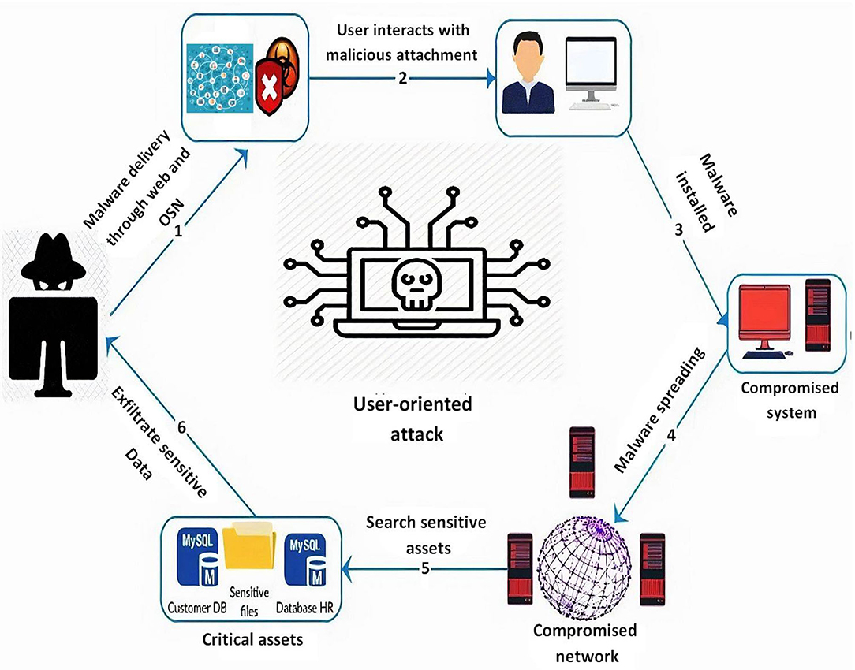
1. Background

Slide 5

File system timeline
Super timeline
Link files
Event logs
Prefetch
Shellbags
Register
FLS – The Sleuth Kit
http://computer-forensics.sans.org/
Notes:
INTRODUCTION page → “All Content is editable
For edit Footer or visible content you must getting to the Master Slide -> click “VIEW” tab -> in the “Master Views” group, click “Slide Master”. (–and- or you can changeyour logo on there”)

Slide 6
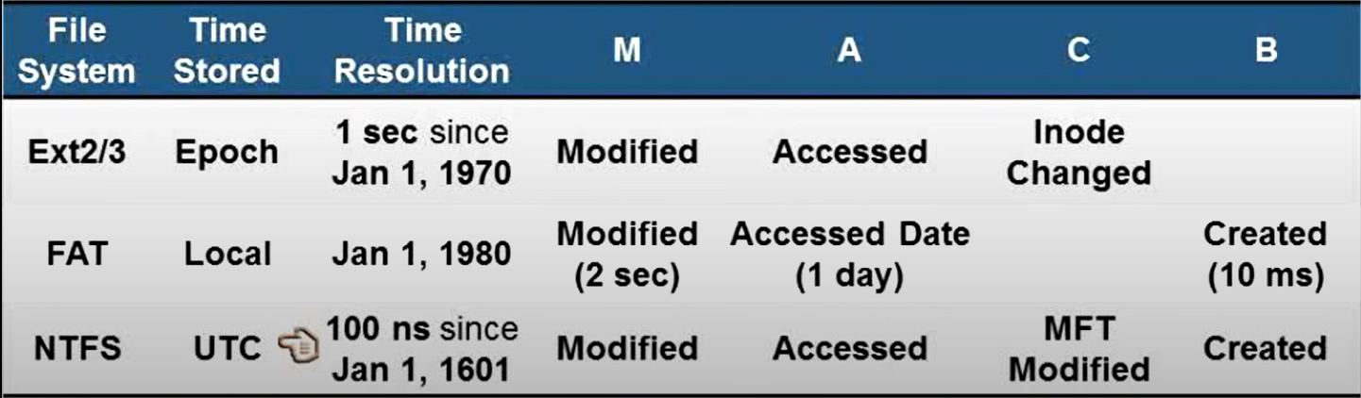
Time resolution in various File System:
http://computer-forensics.sans.org/
Notes:
INTRODUCTION page → “All Content is editable
For edit Footer or visible content you must getting to the Master Slide -> click “VIEW” tab -> in the “Master Views” group, click “Slide Master”. (–and- or you can changeyour logo on there”)

Slide 7
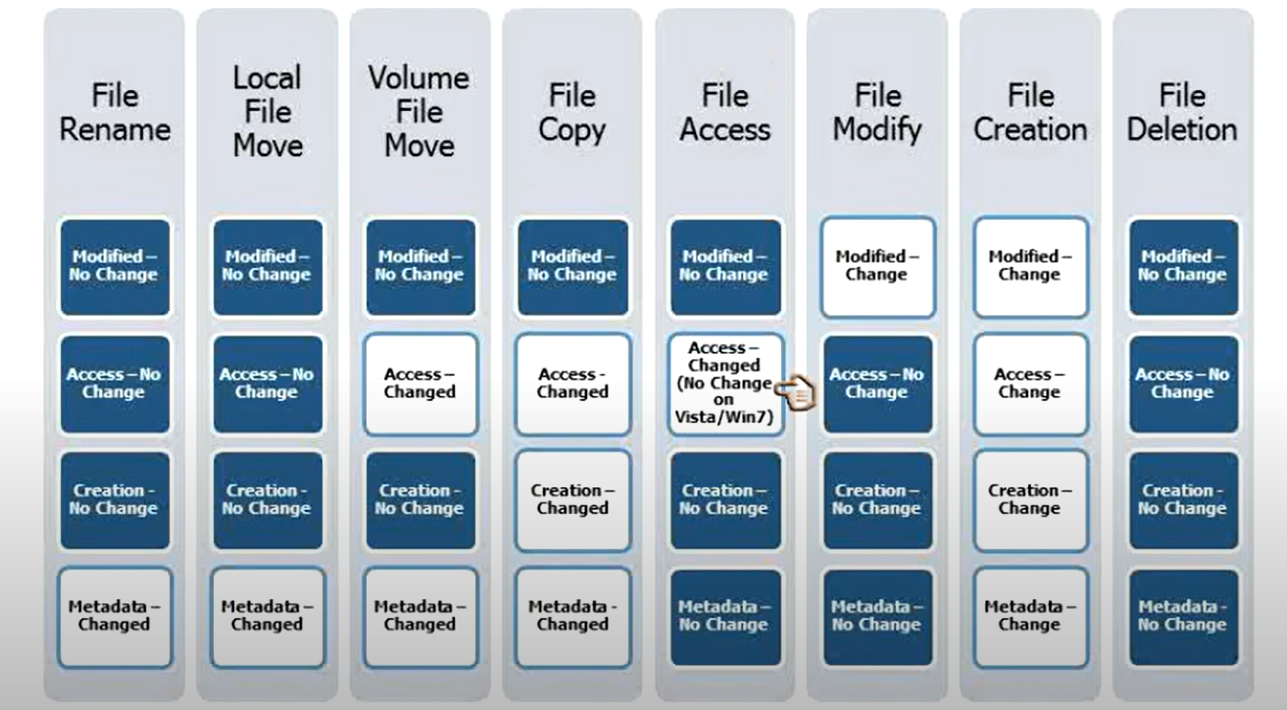
Time-rule updates
http://computer-forensics.sans.org/
Notes:
INTRODUCTION page → “All Content is editable
For edit Footer or visible content you must getting to the Master Slide -> click “VIEW” tab -> in the “Master Views” group, click “Slide Master”. (–and- or you can changeyour logo on there”)

Slide 8

2. Window Supertimeline
Notes:
WELCOME SCREEN → “All Content is editable –and- or you can put your logo on there”
Please Read this Notice Before you start working with this Template
Please Install the following Fonts and/or make sure its already available on your system.
Open Sans Family
Available @ fontsquirell.com
Callibri
Microsoft & Office System Font

Slide 9

File History
Notes:
WELCOME SCREEN → “All Content is editable –and- or you can put your logo on there”
Please Read this Notice Before you start working with this Template
Please Install the following Fonts and/or make sure its already available on your system.
Open Sans Family
Available @ fontsquirell.com
Callibri
Microsoft & Office System Font

Slide 10
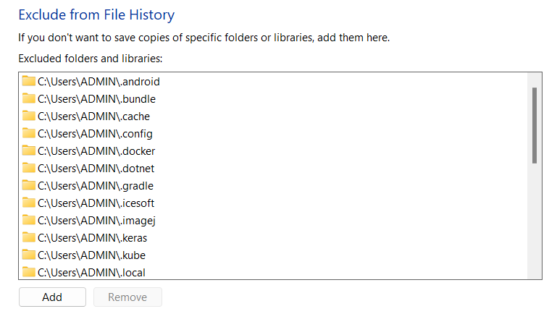
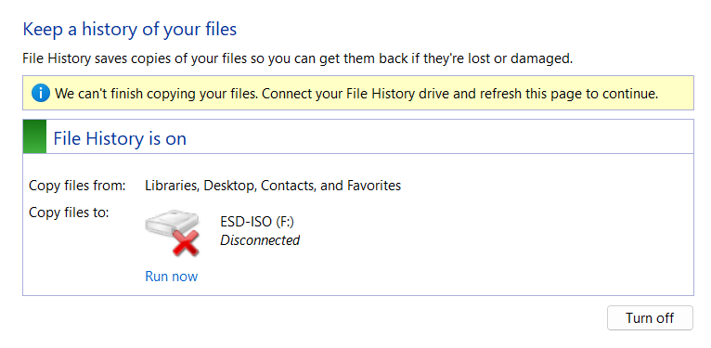

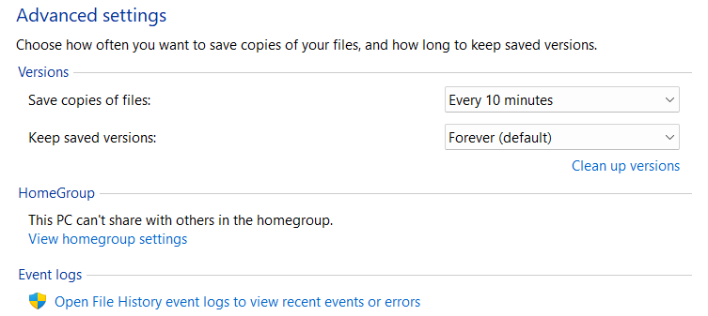

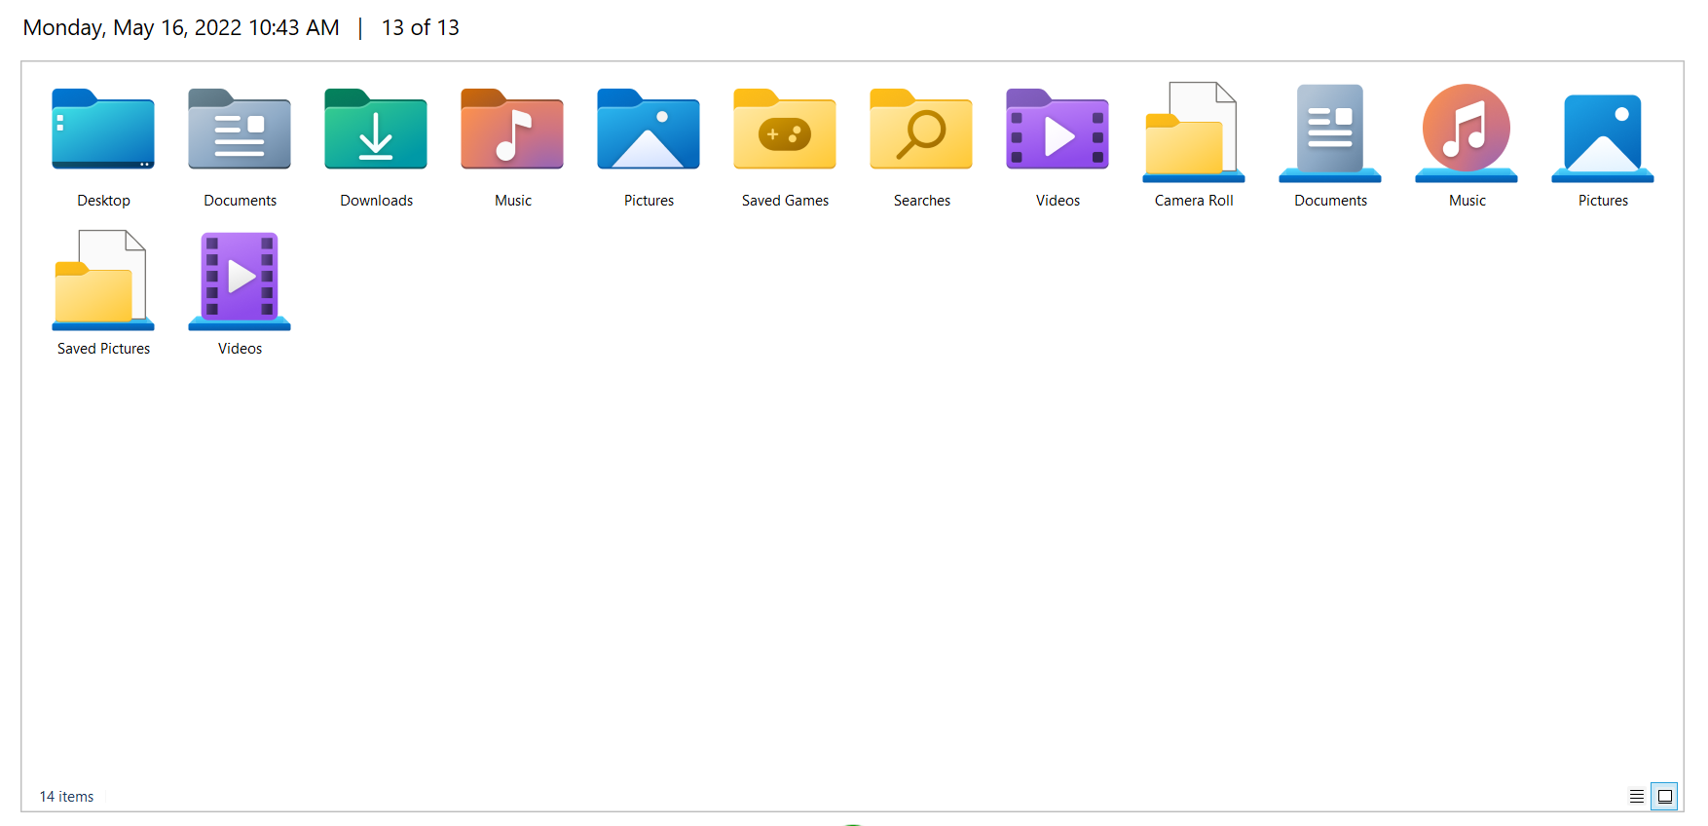
Usage:
Exclude
Time set
Connected Devices
Local backup & restore
Notes:
WELCOME SCREEN → “All Content is editable –and- or you can put your logo on there”
Please Read this Notice Before you start working with this Template
Please Install the following Fonts and/or make sure its already available on your system.
Open Sans Family
Available @ fontsquirell.com
Callibri
Microsoft & Office System Font

Slide 11

Components:
231
Catalog1.edb
Config1.xml
261
381
235
Catalog2.edb
Config2.xml
274
Configurations
Data
Notes:
WELCOME SCREEN → “All Content is editable –and- or you can put your logo on there”
Please Read this Notice Before you start working with this Template
Please Install the following Fonts and/or make sure its already available on your system.
Open Sans Family
Available @ fontsquirell.com
Callibri
Microsoft & Office System Font

Slide 12
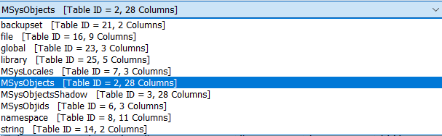
EDB Files
Table | Column | Description (all time-related values are Windows 64-bit timestamps)
backupset | id | Index of backup operation
 | timestamp | Start time of backup operation
file | id | Index of file
 | childId | Foreign key to id column of ‘string’ table (for a file’s name)
 | parentId | Foreign key to id column of ‘string’ table (for a folder where childId is located)
 | fileSize | Backed up file’s size
namespace | childId | Foreign key to id column of ‘string’ table (for a file or folder’s name)
 | parentId | Foreign key to id column of ‘string’ table (for a folder where childId is located)
 | fileRecordId | Foreing key to id column of ‘file’ table
 | fileCreated | File creation time
 | fileModified | File modification time
 | tCreated | Foreign key to id column of ‘backupset’ table
 | usn | Backed up file’s USN
string | id | Index of string
 | string | Backed up file’s name or folder path
Notes:
WELCOME SCREEN → “All Content is editable –and- or you can put your logo on there”
Please Read this Notice Before you start working with this Template
Please Install the following Fonts and/or make sure its already available on your system.
Open Sans Family
Available @ fontsquirell.com
Callibri
Microsoft & Office System Font

Slide 13
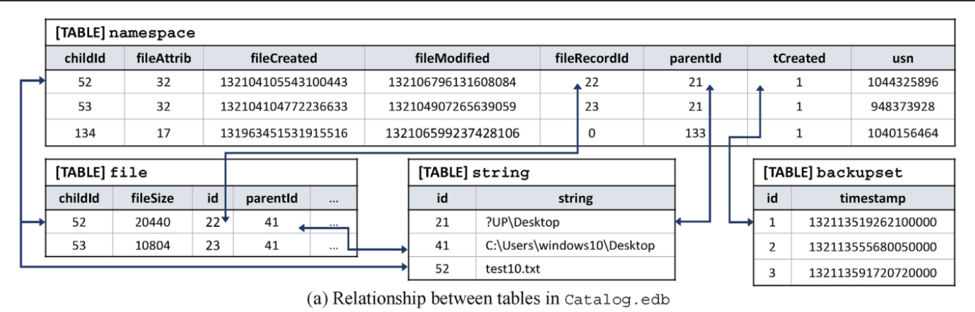
EDB Files
Notes:
WELCOME SCREEN → “All Content is editable –and- or you can put your logo on there”
Please Read this Notice Before you start working with this Template
Please Install the following Fonts and/or make sure its already available on your system.
Open Sans Family
Available @ fontsquirell.com
Callibri
Microsoft & Office System Font

Slide 14
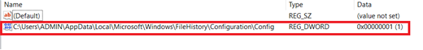
Registry
Registry could be a good place to find potential evidence related to FileHistory
1- Upon turning on the File History, a value C:\Users\Username\AppData\Local\Microsoft\Windows\FileHistory\Configuration\Config gets added with data 0×00000001, inside the key HKLM\SYSTEM\CurrentControlSet\Services\fhsvc\Parameters\Configs.
2- There is another registry key that can be used to determine the state (ON or OFF) of the File History is
HKLM\SYSTEM\CurrentControlSet\Services\fhsvc\Start: 0×00000003 (OFF)
HKLM\SYSTEM\CurrentControlSet\Services\fhsvc\Start: 0×00000002 (ON)
Notes:
WELCOME SCREEN → “All Content is editable –and- or you can put your logo on there”
Please Read this Notice Before you start working with this Template
Please Install the following Fonts and/or make sure its already available on your system.
Open Sans Family
Available @ fontsquirell.com
Callibri
Microsoft & Office System Font

Slide 15
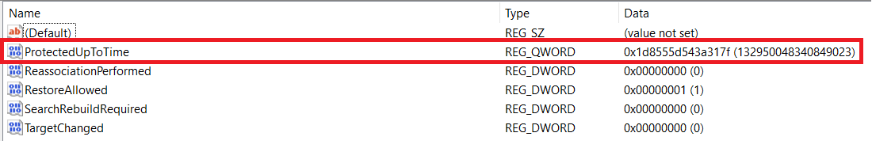
Registry
3- Registry analysis can also let the examiner know about last backup time. The registry key HKEY_CURRENT_USER\Software\Microsoft\Windows\CurrentVersion\FileHistory contains a value ‘ProtectedUpToTime’ with timestamp data in 64 bit hex value big endian format.
Notes:
WELCOME SCREEN → “All Content is editable –and- or you can put your logo on there”
Please Read this Notice Before you start working with this Template
Please Install the following Fonts and/or make sure its already available on your system.
Open Sans Family
Available @ fontsquirell.com
Callibri
Microsoft & Office System Font

Slide 16
Event:
Examination of event logs could be a vital step in timeline analysis and co-relating the findings. Log files related to File History can be found in Applications and Service Logs -> Microsoft -> Windows. We found following two interesting event files:
WHC
File History Backup Log
The entries of Information level in WHC appears whenever File History runs, stops, turns off or on. On the other hand, File History Backup Log records warnings or error messages,
Notes:
WELCOME SCREEN → “All Content is editable –and- or you can put your logo on there”
Please Read this Notice Before you start working with this Template
Please Install the following Fonts and/or make sure its already available on your system.
Open Sans Family
Available @ fontsquirell.com
Callibri
Microsoft & Office System Font

Slide 17
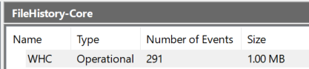
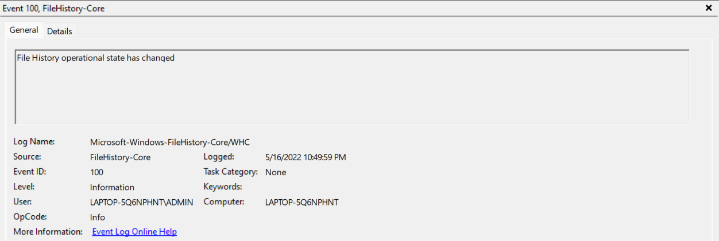
Event:
WHC under FileHistory-Core
Notes:
WELCOME SCREEN → “All Content is editable –and- or you can put your logo on there”
Please Read this Notice Before you start working with this Template
Please Install the following Fonts and/or make sure its already available on your system.
Open Sans Family
Available @ fontsquirell.com
Callibri
Microsoft & Office System Font

Slide 18
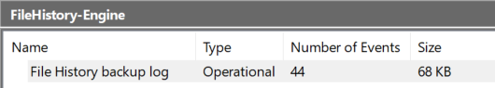
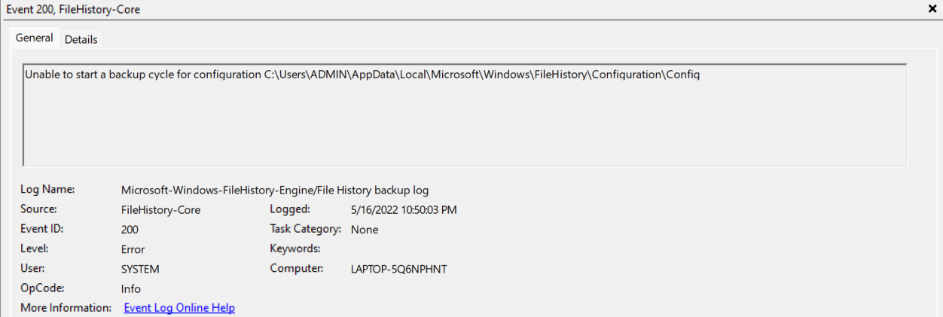
Event:
File History Backup Log under FileHistory-Engine
Notes:
WELCOME SCREEN → “All Content is editable –and- or you can put your logo on there”
Please Read this Notice Before you start working with this Template
Please Install the following Fonts and/or make sure its already available on your system.
Open Sans Family
Available @ fontsquirell.com
Callibri
Microsoft & Office System Font

Slide 19

3. Anti-forensic
a. Files are deleted from external storage:
b. Disabling and re-enabling of a backup storage device
c. Disconnecting an active backup storage device
Notes:
WELCOME SCREEN → “All Content is editable –and- or you can put your logo on there”
Please Read this Notice Before you start working with this Template
Please Install the following Fonts and/or make sure its already available on your system.
Open Sans Family
Available @ fontsquirell.com
Callibri
Microsoft & Office System Font

Slide 20
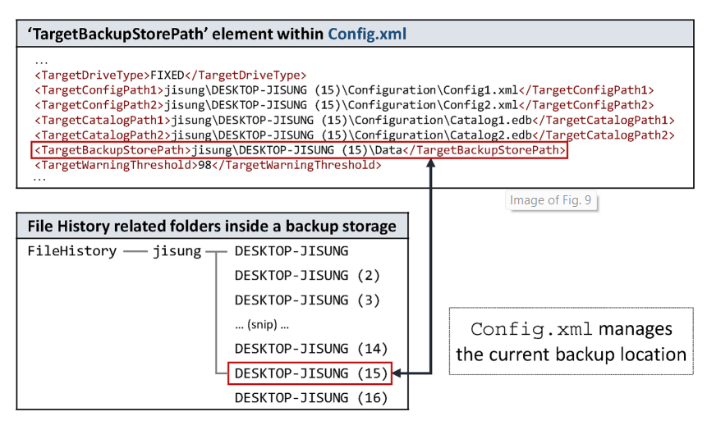
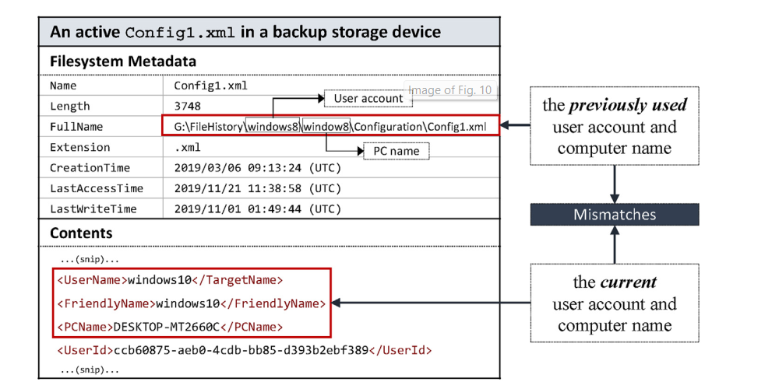
b. Disabling and re-enabling of a backup storage device
Many version of a file marked by ordinal number
Metadata mismatch
Notes:
WELCOME SCREEN → “All Content is editable –and- or you can put your logo on there”
Please Read this Notice Before you start working with this Template
Please Install the following Fonts and/or make sure its already available on your system.
Open Sans Family
Available @ fontsquirell.com
Callibri
Microsoft & Office System Font

Slide 21
Volatility
gditimers Print installed GDI timers and callbacks
shutdowntime Print ShutdownTime of machine from registry
timeliner Creates a timeline from various artifacts in memory
timers Print kernel timers and associated module DPCs
Shellbags Print shellbags info
Mftparser Scans for and parses potential MFT entries
The Volatility Foundation - Open Source Memory Forensics
Notes:
WELCOME SCREEN → “All Content is editable –and- or you can put your logo on there”
Please Read this Notice Before you start working with this Template
Please Install the following Fonts and/or make sure its already available on your system.
Open Sans Family
Available @ fontsquirell.com
Callibri
Microsoft & Office System Font

Slide 22

4. 1. Linux Supertimeline
Notes:
WELCOME SCREEN → “All Content is editable –and- or you can put your logo on there”
Please Read this Notice Before you start working with this Template
Please Install the following Fonts and/or make sure its already available on your system.
Open Sans Family
Available @ fontsquirell.com
Callibri
Microsoft & Office System Font

Slide 23
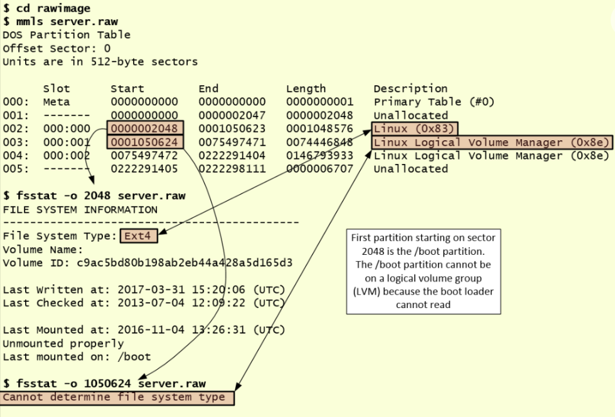
Using the “mmls” utility ➔ obtain information about sector’s starts
Notes:
WELCOME SCREEN → “All Content is editable –and- or you can put your logo on there”
Please Read this Notice Before you start working with this Template
Please Install the following Fonts and/or make sure its already available on your system.
Open Sans Family
Available @ fontsquirell.com
Callibri
Microsoft & Office System Font

Slide 24
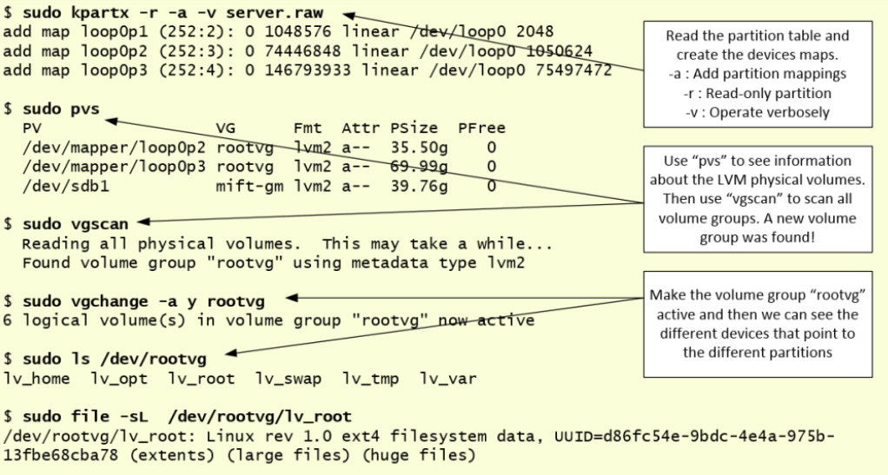
We start with “kpartx” which will automate the creation of the partition devices by creating loopback devices and mapping them
Then, we use the different utilities that manage LVM volumes such as “pvs”, “vgscan” abd “vgchange”
Notes:
WELCOME SCREEN → “All Content is editable –and- or you can put your logo on there”
Please Read this Notice Before you start working with this Template
Please Install the following Fonts and/or make sure its already available on your system.
Open Sans Family
Available @ fontsquirell.com
Callibri
Microsoft & Office System Font

Slide 25
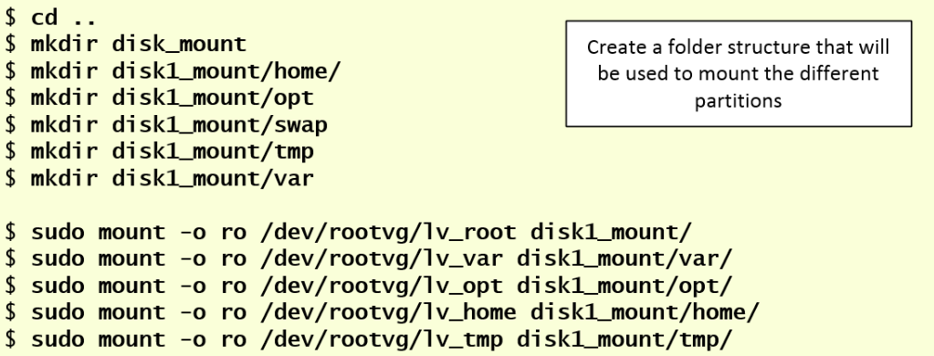
Mount the different volumes as read-only as we would mount a normal device for forensic analysis
Notes:
WELCOME SCREEN → “All Content is editable –and- or you can put your logo on there”
Please Read this Notice Before you start working with this Template
Please Install the following Fonts and/or make sure its already available on your system.
Open Sans Family
Available @ fontsquirell.com
Callibri
Microsoft & Office System Font

Slide 26
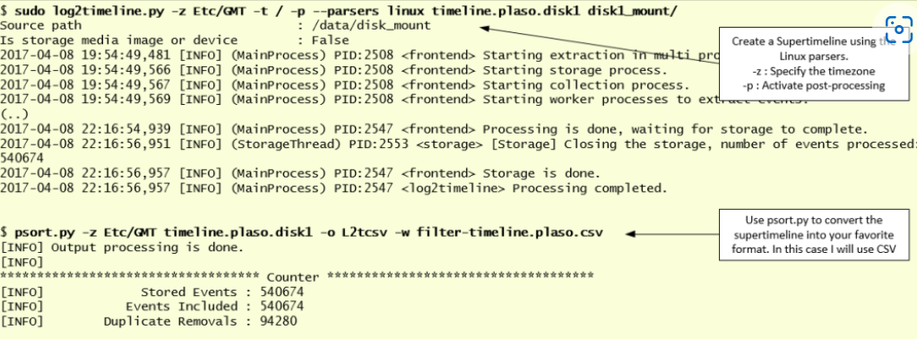
Use framework log2timeline.py (Plaso)
Notes:
WELCOME SCREEN → “All Content is editable –and- or you can put your logo on there”
Please Read this Notice Before you start working with this Template
Please Install the following Fonts and/or make sure its already available on your system.
Open Sans Family
Available @ fontsquirell.com
Callibri
Microsoft & Office System Font

Slide 27
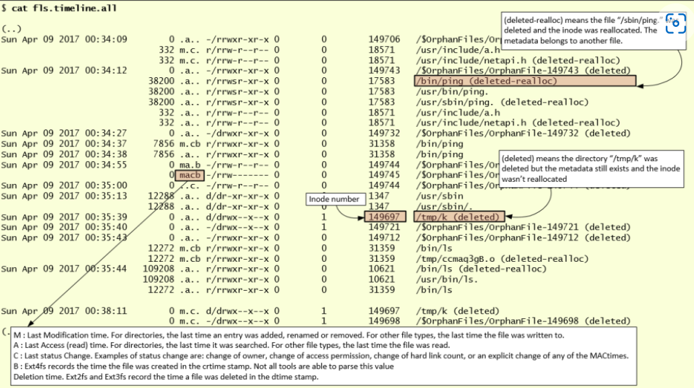
Use framework log2timeline.py (Plaso)
Notes:
WELCOME SCREEN → “All Content is editable –and- or you can put your logo on there”
Please Read this Notice Before you start working with this Template
Please Install the following Fonts and/or make sure its already available on your system.
Open Sans Family
Available @ fontsquirell.com
Callibri
Microsoft & Office System Font

Slide 28
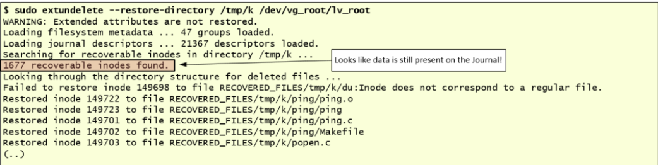
Recover deleted data is using the tool “extundelete”
Notes:
WELCOME SCREEN → “All Content is editable –and- or you can put your logo on there”
Please Read this Notice Before you start working with this Template
Please Install the following Fonts and/or make sure its already available on your system.
Open Sans Family
Available @ fontsquirell.com
Callibri
Microsoft & Office System Font

Slide 29

4.2. Web Timeline
Notes:
WELCOME SCREEN → “All Content is editable –and- or you can put your logo on there”
Please Read this Notice Before you start working with this Template
Please Install the following Fonts and/or make sure its already available on your system.
Open Sans Family
Available @ fontsquirell.com
Callibri
Microsoft & Office System Font

Slide 30
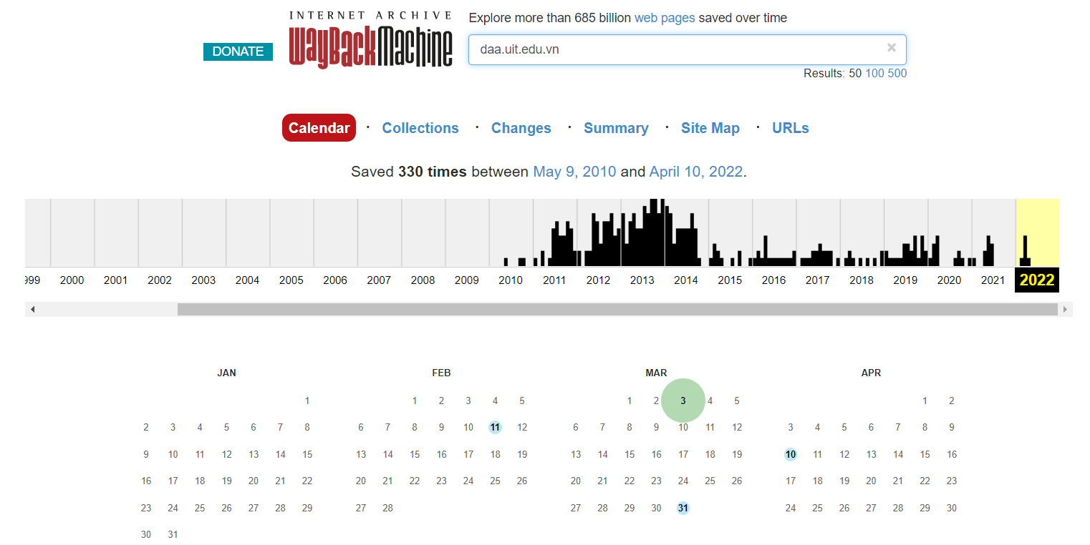
Web Timeline
Internet Archive: Wayback Machine
Notes:
WELCOME SCREEN → “All Content is editable –and- or you can put your logo on there”
Please Read this Notice Before you start working with this Template
Please Install the following Fonts and/or make sure its already available on your system.
Open Sans Family
Available @ fontsquirell.com
Callibri
Microsoft & Office System Font

Slide 31
5. Plaso – Log2timeline
(Demo)
log2timeline/plaso: Super timeline all the things (github.com)
Notes:
WELCOME SCREEN → “All Content is editable –and- or you can put your logo on there”
Please Read this Notice Before you start working with this Template
Please Install the following Fonts and/or make sure its already available on your system.
Open Sans Family
Available @ fontsquirell.com
Callibri
Microsoft & Office System Font

Slide 32
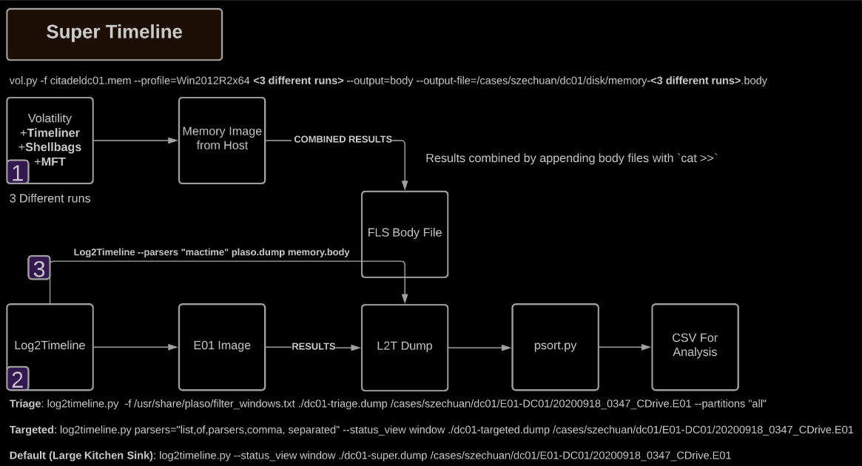

Slide 33
Tools for timeline:
• EnCase, FTK • Log2Timeline • The Sleuth Kit (ils, fls, mactime), PTK, Autopsy, Fiwalk • Ex-Tip • NTI FileList Pro • Zeitline (Buchholz & Falk, 2005)
• AnalyzeMFT.py • Mac-robber • DFF (Digital Forensic Framework) • The Coroner’s Toolkit (grave-robber, mactime) • NFILabs Aftertime • SIMILE Timeplot
Notes:
WELCOME SCREEN → “All Content is editable –and- or you can put your logo on there”
Please Read this Notice Before you start working with this Template
Please Install the following Fonts and/or make sure its already available on your system.
Open Sans Family
Available @ fontsquirell.com
Callibri
Microsoft & Office System Font

Slide 34
Reference
Main:
https://www.sciencedirect.com/science/article/pii/S2666281721000329
File Systems – Forensic Focus – Articles (rssing.com)
https://docplayer.net/9932295-File-history-analysis-windows-8.html
Timeline2GUI: A Log2Timeline CSV parser and training scenarios - ScienceDirect
SuperTimeline | Count Upon Security
Github:
NT334.M21.ANTN-Digital-Forensic/Seminar at main · khangtictoc/NT334.M21.ANTN-Digital-Forensic (github.com)
Notes:
INTRODUCTION page → “All Content is editable
For edit Footer or visible content you must getting to the Master Slide -> click “VIEW” tab -> in the “Master Views” group, click “Slide Master”. (–and- or you can changeyour logo on there”)

Slide 35
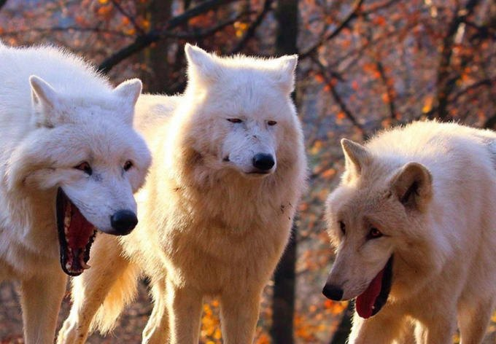
Thanks for your listening !!!
Notes:
INTRODUCTION page → “All Content is editable
For edit Footer or visible content you must getting to the Master Slide -> click “VIEW” tab -> in the “Master Views” group, click “Slide Master”. (–and- or you can changeyour logo on there”)

